Slide 1
Relational Model
UNIT-II
Part-1
Structure of Relational DB
, Database Schema, Keys

Slide 2
Structure of Relational DB
A database that can be perceived as a set of tables and manipulated in accordance with the relational model of data. Each database includes:a set of system catalog tables that describe the logical and physical structure of the data
a configuration file containing the parameter values allocated for the database
a recovery log with ongoing transactions and archivable transactions
Reference link: https://www.ibm.com/docs/en/mfci/7.6.2?topic=design-relational-database-structure

Slide 3
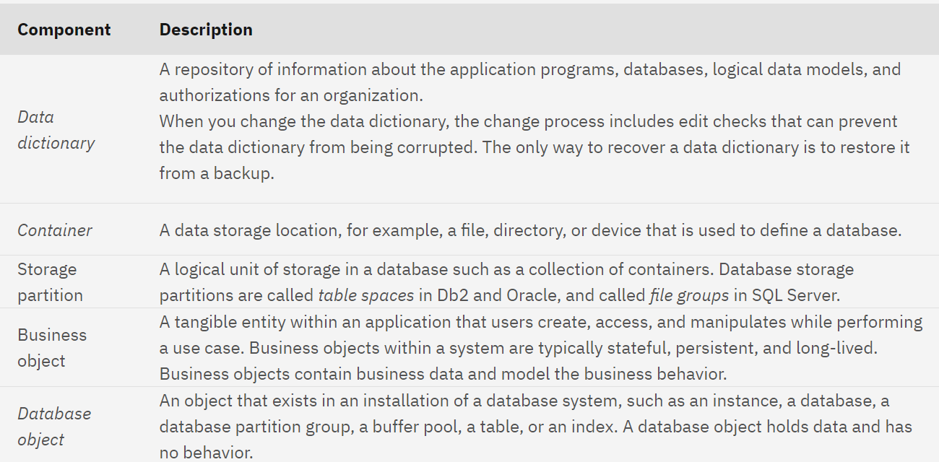

Slide 4
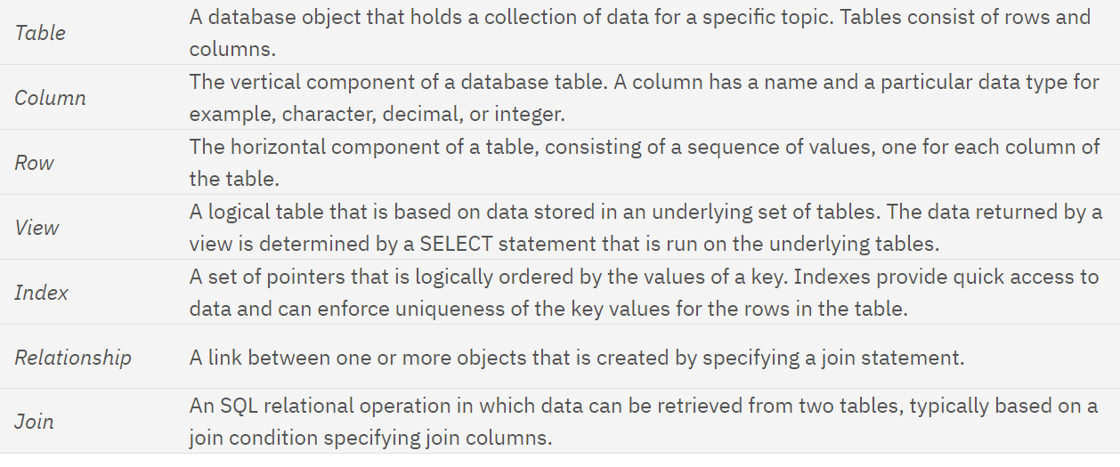

Slide 5
Relational DB
Attribute data types Each database record contains multiple attributes. Every attribute has an associated data type.
Database views A database view is a subset of a database and is based on a query that runs on one or more database tables. Database views are saved in the database as named queries and can be used to save frequently used, complex queries.
Indexes You can use indexes to optimize performance for fetching data. Indexes provide pointers to locations of frequently accessed data. You can create an index on the columns in an object that you frequently query.
Primary keys When you assign a primary key to an attribute, the key uniquely identifies the object that is associated with that attribute. The value in the primary column determines which attributes are used to create the primary key.

Slide 6
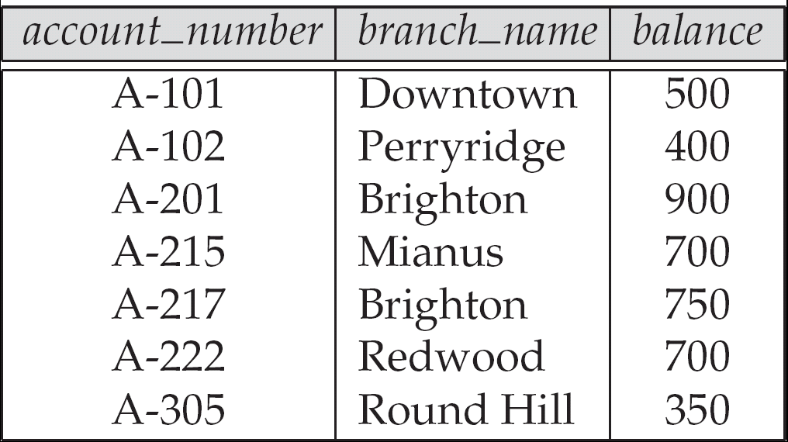
Example of a Relation

Slide 7
Basic Structure
Formally, given sets D₁, D₂, …. D_{n} a relation r is a subset of D₁ x D₂ x … x D_{n} Thus, a relation is a set of n-tuples (a₁, a₂, …, a_{n}) where each a_{i} ∈ D_{i}
Example: If customer_name = {Jones, Smith, Curry, Lindsay} customer_street = {Main, North, Park} customer_city = {Harrison, Rye, Pittsfield} Then r = { (Jones, Main, Harrison), (Smith, North, Rye), (Curry, North, Rye), (Lindsay, Park, Pittsfield) } is a relation over
customer_name x customer_street x customer_city

Slide 8
Attribute Types
Each attribute of a relation has a name
The set of allowed values for each attribute is called the domain of the attribute
Attribute values are (normally) required to be atomic; that is, indivisible
Note: multivalued attribute values are not atomic
Note: composite attribute values are not atomic
The special value null is a member of every domain
The null value causes complications in the definition of many operations
We shall ignore the effect of null values in our main presentation and consider their effect later

Slide 9
Relation Schema
A₁, A₂, …, A_{n} are attributes
R = (A₁, A₂, …, A_{n} ) is a relation schema
Example:
Customer_schema = (customer_name, customer_street, customer_city)
r(R) is a relation on the relation schema R
Example:
customer (Customer_schema)

Slide 10
Relation Instance
The current values (relation instance) of a relation are specified by a table
An element t of r is a tuple, represented by a row in a table
attributes
(or columns)
customer_name
customer_street
customer_city
Jones
Smith
Curry
Lindsay
Main
North
North
Park
Harrison
Rye
Rye
Pittsfield
tuples
(or rows)
customer

Slide 11
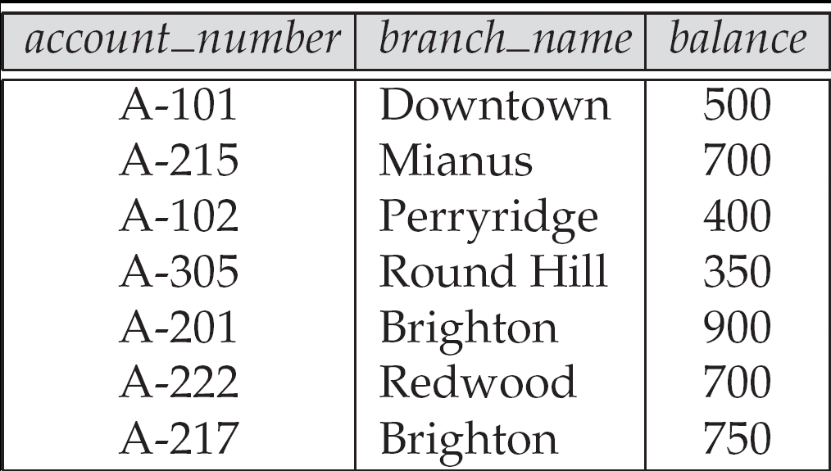
Relations are Unordered
Order of tuples is irrelevant (tuples may be stored in an arbitrary order)
Example: account relation with unordered tuples

Slide 12
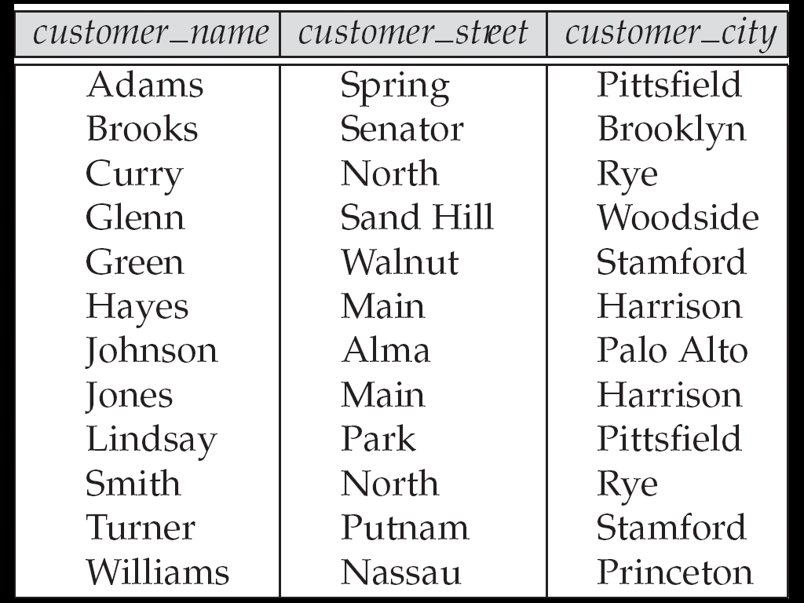
The customer Relation

Slide 13
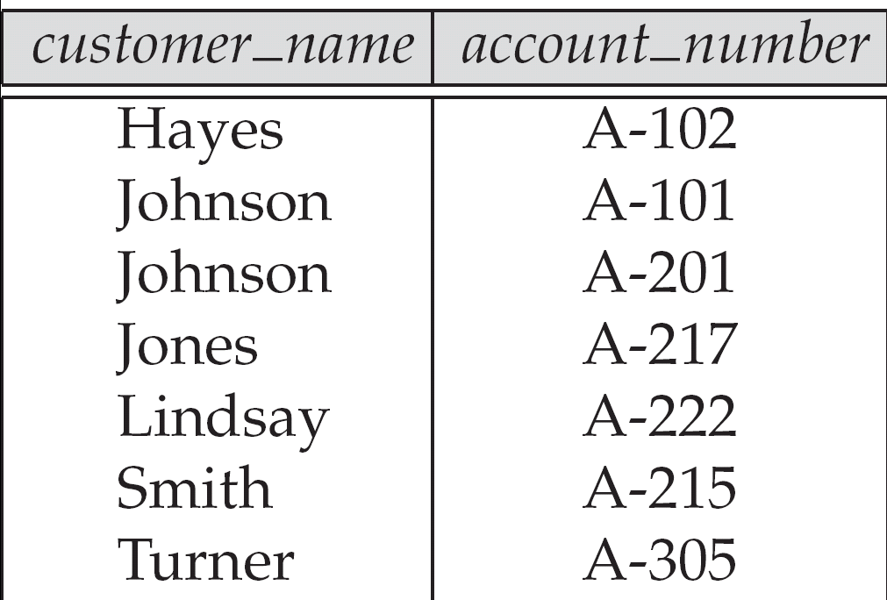
The depositor Relation

Slide 14
Relational database schema
a Relational database schema is an arrangement of relation states in such a manner that every relational database state fulfills the integrity constraints set on a relational database schema.
A database schema includes a relational schema for each of its tables and a set of integrity constraints

Slide 15
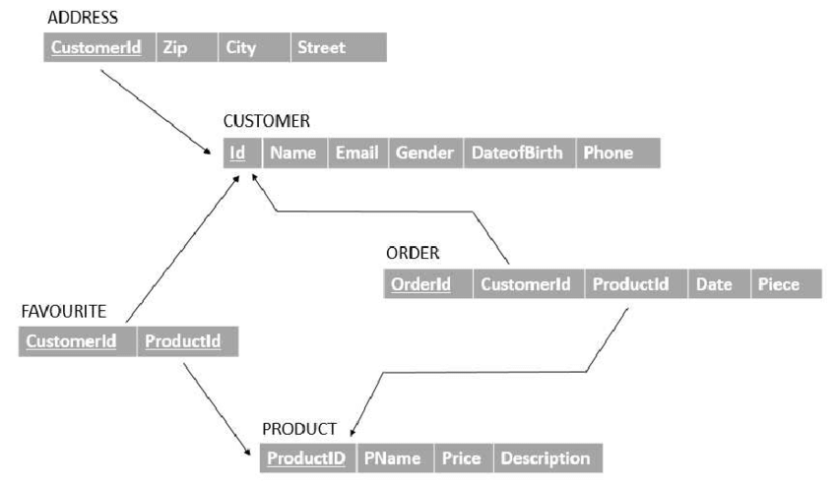
Relational database schema

Slide 16
Keys in RDBMS
A key refers to an attribute/a set of attributes that help us identify a row (or tuple) uniquely in a table (or relation).
A key is also used when we want to establish relationships between the different columns and tables of a relational database.

Slide 17
Types of Keys in DBMS
Super Key
Candidate Key
Primary Key
Alternate Key
Foreign Key
Composite Key
Unique Key

Slide 18
Super Key
A super key refers to the set of all those keys that help us uniquely identify all the rows present in a table.
It means that all of these columns present in a table that can identify the columns of that table uniquely act as the super keys.
A super key is a candidate key’s superset (candidate key has been explained next).
We need to pick the primary key of any table from the super key’s set so as to make it the table’s identity attribute.

Slide 19
Candidate Key
The candidate keys refer to those attributes that identify rows uniquely in a table. In a table, we select the primary key from a candidate key. Thus, a candidate key has similar properties as that of the primary keys.
In a table, there can be multiple candidate keys.

Slide 20
Primary Key
The primary key refers to a column or a set of columns of a table that helps us identify all the records uniquely present in that table.
A table can consist of just one primary key.
Also, this primary key cannot consist of the same values reappearing/repeating for any of its rows.
The PK (PRIMARY KEY) constraint that we put on a column/set of columns won’t allow these to have a null value or a duplicate.
Any table can consist of only a single primary key constraint.
A foreign key (explained below) that refers to it can never change the values present in the primary key.

Slide 21
Properties of PK
It is a unique key.
It can identify only one tuple (a record) at a time.
It has no duplicate values.
it has unique values.
It cannot be NULL.
Primary keys are not necessarily to be a single column; more than one column can also be a primary key for a table.

Slide 22
Alternate Key
All those keys that did not become a primary key are known as alternate keys.
Foreign Key
We use a foreign key to establish relationships between two available tables.
The foreign key would require every value present in a column/set of columns to match the referential table’s primary key.
A foreign key helps us to maintain data as well as referential integrity.

Slide 23
Composite Key
The composite key refers to a set of multiple attributes that help us uniquely identify every tuple present in a table.
The attributes present in a set may not be unique whenever we consider them separately.
Thus, when we take them all together, it will ensure total uniqueness.
Unique Key
A unique key refers to a column/a set of columns that identify every record uniquely in a table.
All the values in this key would have to be unique.
Remember that a unique key is different from a primary key. Because it is only capable of having one null value.
A primary key, on the other hand, cannot have a null value.

Slide 24
Example: consider below set of Super keys
ABC -> ABC
AB -> C
AC -> B
BC -> A
A -> BC
B -> AC
C -> AB
From all the super keys available, the candidate key is the one whose proper subset is not a super key

Slide 25
Selection of candidate key
But now, the given set of the super key is:
ABC-> ABC AB -> C BC -> A A -> BC
Given ABC key, we’re saying if we find its proper subset, i.e., {A, B, C, AB, AC, BC} and any of them can be a key, then ABC can’t become a candidate key.
AB, which comes from the proper subset of ABC, is also a key. Therefore, ABC is not a candidate key.

Slide 26
Selection of candidate key
Note: If x is a proper subset of y, then x must NOT have one element that is included in y. Example,
X = {1,2,3} Y = {1,2,3,4}
Here, we can say X is a proper subset of Y since X doesn’t have 4 in it.
Similarly, AB is also not a candidate key because we have got A in its proper subset which, can be used as a key. Therefore, at last, we found that A is the ONLY candidate key available for the above schema.

Slide 27
Selection of primary key
The primary key is nothing but a candidate key which has given the right to be called the primary key.
All other candidate keys can also be used as a primary key, but the database administrator (or you) can choose a single key out of those to be a primary key. We can use the primary key to uniquely identify the records of a table.

Slide 28
Selection of CK, primary key
Now we have a set of the super key as,
ABC-> ABC
AB -> C
BC -> A
A -> BC
B -> AC
C -> AB
Out of those, A, B, and C are valid candidate keys.
From A, B, and C, we can choose either A, B, or C as primary key.
One may choose A, other can choose B, and both are fine.

Slide 29
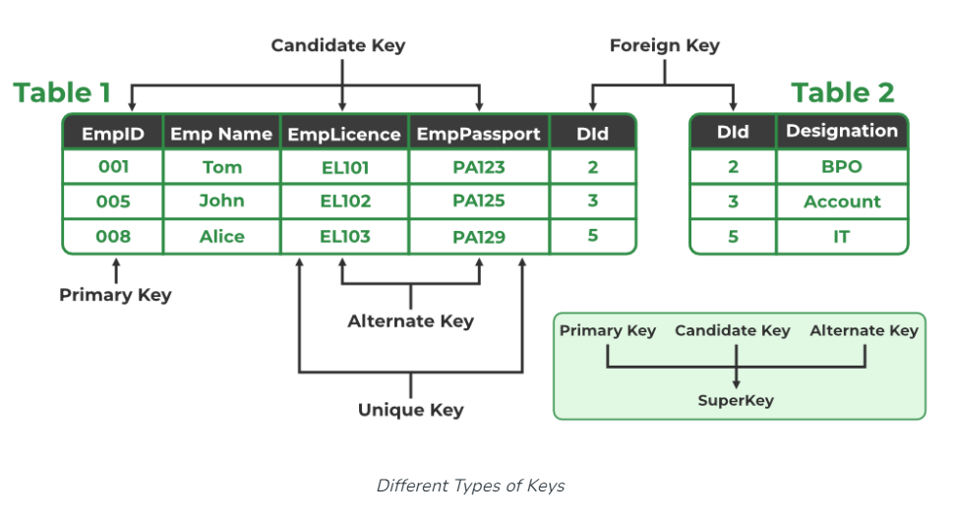
Types of keys in DBMS

Slide 30
NULL values
We pay special attention to the NULL value in a database.
Intuitively, NULL means that the value is not known or may not exist.
For example, the value of an age attribute may be NULL if it's not known, whereas the value of spouse could be either unknown or may not exist.
The important property to keep in mind about the NULL value is that an equality test involving a NULL returns NULL.
In fact, even NULL = NULL returns NULL.
We can test explicitly for NULL with the predicate is NULL.

